Slide 1
The Hodgkin-Huxley Model
Introduction to neural networks - Assignment 2
By: Nadav Porat
19/4/20

Slide 2
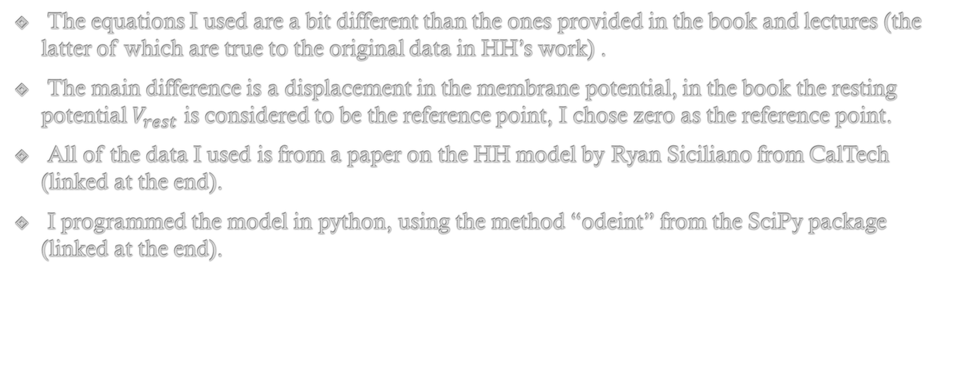
Notes
The equations I used are a bit different than the ones provided in the book and lectures (the latter of which are true to the original data in HH’s work) .
The main difference is a displacement in the membrane potential, in the book the resting potential $V_{rest}$ is considered to be the reference point, I chose zero as the reference point.
All of the data I used is from a paper on the HH model by Ryan Siciliano from CalTech (linked at the end).
I programmed the model in python, using the method “odeint” from the SciPy package (linked at the end).

Slide 3
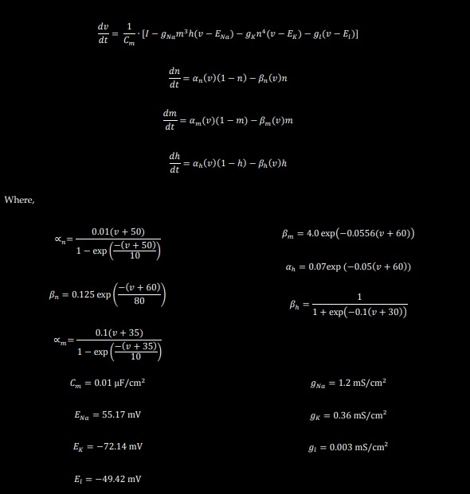
Analytical Background

Slide 4
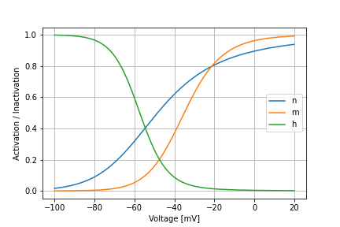
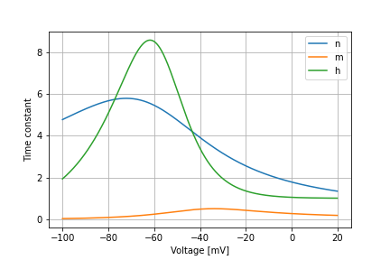
The action potential parameters
The parameters making the action potential (AP) are n,m and h (the sodium and potassium gate parameters). Their action is described by their activation constants and their time constants (as functions of the voltage).

Slide 5
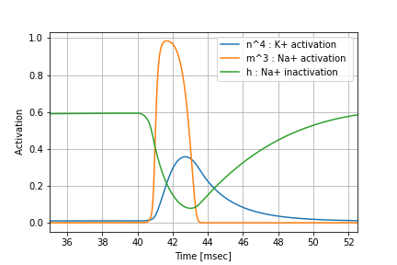
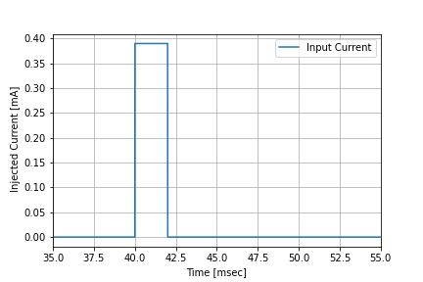

The action potential parameters
The activation parameters as a function of time (on the left) in response to an input current above threshold (on the right). We can see the $m^{3}$ goes up incredibly fast (less than 1msec), meaning that the sodium channels open very fast – as expected.

Slide 6
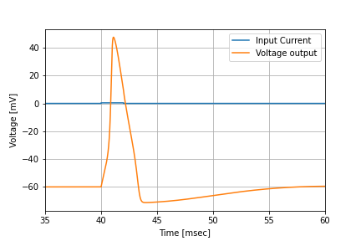
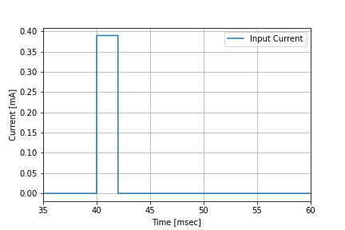
The action potential
The AP generated as a result from the parameters (on the right).
The input current is the same from the last slide, it can be seen in the right and in the little bump near the AP.

Slide 7
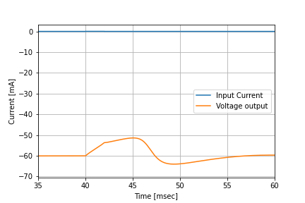
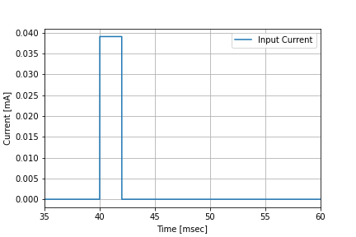
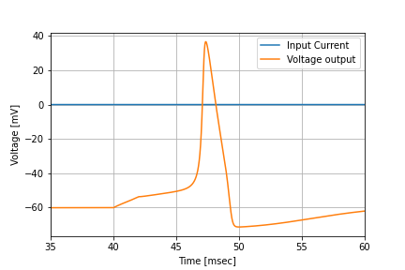


The threshold
The AP has a current threshold, any current below the threshold will not trigger an AP. The threshold is about $I_{in}=0.039 \left[mA\right].$
For an input current lower than $0.039 mA$, for example $0.038mA:$
$$I_{inj}=38 μA$$

Slide 8

The threshold
And just slightly above:
$$I_{inj}=39 μA$$

Slide 9
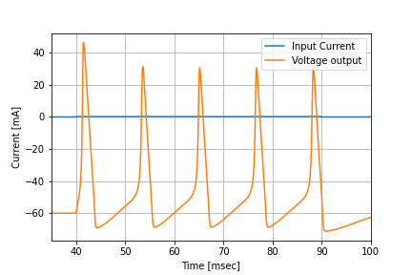
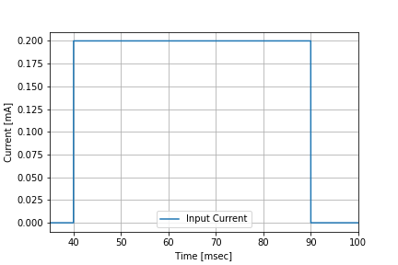
Steady current response
The HH model responds to a steady current (greater than the threshold value) by generating multiple AP.

Slide 10
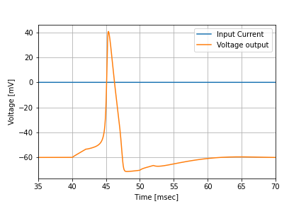
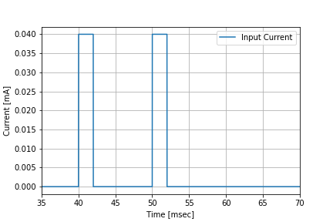
Refractory period
We can see the refractory period by sending another pulse right after the first AP, before the system came to equilibrium. The second pulse didn’t initiate an AP, instead it created a little bump in the hyperpolarization period.
Lil’ bump

Slide 11
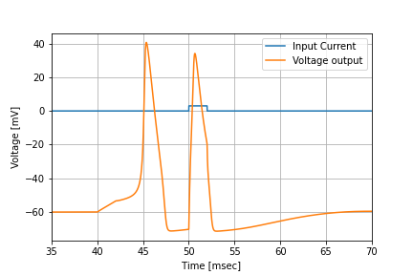
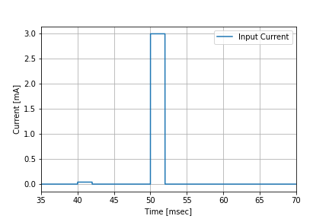
Refractory period
We can overcome the refractory period by sending a strong second pulse.

Slide 12
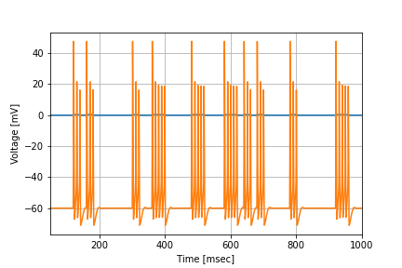
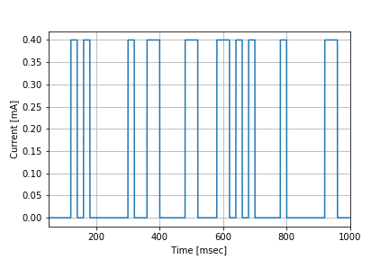

Poisson’s distribution input
The Poisson's distribution details the occurrence of independent events with frequency $λ.$
In the following example we see the reaction to current input drawn from the Poisson distribution with frequency $λ=0.32 kHz.$ We can see that the voltage output is characterized by “bursts” or “clusters” of many AP.

Slide 13
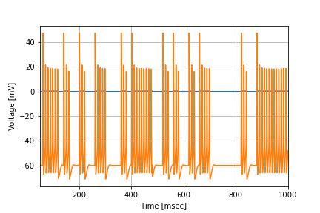
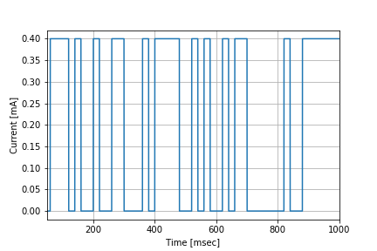

Poisson’s distribution input
And with frequency $λ=0.5 kHz$:

Slide 14
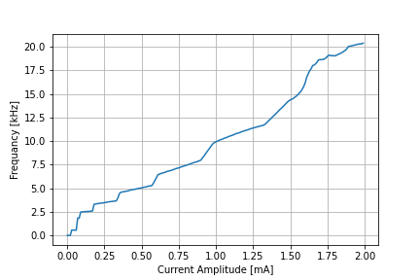
AP frequency
The frequency of firing AP raises as the amplitude of the input (steady) current arises. In order to demonstrate this, I programmed a function to print the frequency in relation to different amplitudes and plotted the results:
Side note: the amplitude of the multiple AP’s decrease as the frequency raises.

Slide 15
Bibliography
The theoretical equations on which my work is based can be found here: Ryan Siciliano , The Hodgkin – Huxley model, CalTech, 6/3/12 - Link.
My code can be found here: Link.

